Slide 1


Solving Problem with Innovative Solutions

Slide 2


Today's agenda
Project recap
Problem
The Analytics team
Process
Insights
Summary

Slide 3

Project Recap
We will data collection and storage, data cleaning and preprocessing, data integration and merging, data analysis and visualization.

Slide 4

Problem
The goal is to assist Social Buzz in optimizing their big data practices, preparing for the IPO, and showcasing the benefits of implementing sound data analytics processes.

Slide 5
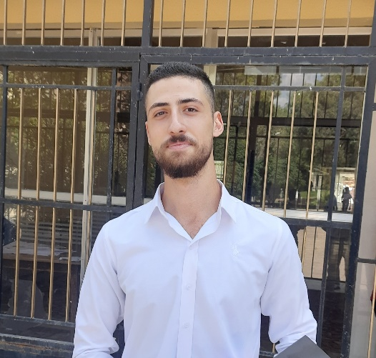


Hazem Hamdan
(Data Analyst),
The Analytics team
Andrew Fleming
(Chief Technical Architect),
Marcus Rompton
(Senior Principle)

Slide 6
Process
1
Prepare
2
Process
3
Analyze
4
Visualize
5
Present

Slide 7

Insights
The top 5 Categories :
Animals
Science
Healthy Eating
Technology
Food
1897
reactions to "Animal" posts which is the most common category.
January
is the month with the most posts

Slide 10
Thank you!

